Slide 1
SAP Concur
Top Accounts Strategy & Program
Denise Kamstra, Senior Director, Global Targeted Audience Marketing
Guy Arama, VP, Global Audience Marketing

Slide 2
Agenda
Why top accounts, why now
What is the Top Accounts Program
Who are we targeting
What’s included in the Top Accounts Program
Working together

Slide 3
Why top accounts?
Why ABM?
Why now?

Slide 4


What we’re hearing from sales & marketing
“Lack of insight into key account and contact activity.”
“Marketing wants to help drive greatest impact w/ flat resources.”
“Delivery assets are too SAP Concur focused.”
“Inability to target accounts with the right fit for the business.”
“Need strategy that is consistent and tactics that are scalable and
“Want better alignment between marketing and sales.”

Slide 5





The challenges sales teams are facing
More channels influencing buying decisions
Decision-making teams are growing
- becoming more complex
New digital entrants
arriving with agility
and speed
New roles emerging
and increasingly influential
Commoditisation in industries such as Cloud making it harder to differentiate
Notes:
• More IT spend concentrated across more people including the hands of the business
• Increasingly complex decision making units
• New non-traditional personas appearing e.g. Chief Digital Officer
• Teams are under fierce pressure from the board – do more with less, accelerate change

Slide 6
WHERE WE’VE BEEN |  | WHERE WE ARE GOING
Marketing to Accounts |  | ABM for Top Accounts
Similar messages Tactics and offers focused on what we want to tell or sell Accounts scored like leads based on fit and activity |  | Tailored, insight-based messages Aligned with account growth strategy Focus on what customers want Tactics chosen based on account insights, preferences and needs
Success = new leads to sales |  | Success = coverage, pipeline velocity, deal sizes, relationship health
Notes:
What are some key differences between the approaches of marketing to accounts versus account based marketing?
Increasingly, b-to-b marketers are striving for a higher level of precision and relevance when selecting and engaging with the selected market, target or existing accounts. At two ends of the demand spectrum are strategies that are most commonly applied, namely, marketing to accounts and account-based marketing. Both approaches are viable strategies for b-to-b companies (and the terms are often used interchangeably) but there are important differences that must be understood. The distinctions between approaches can be better understood by accounting for a number of different considerations:
Account selection and prioritization. While both marketing to accounts and account-based marketing incorporate the creation of a defined universe of accounts. When marketing to accounts, business and segmentation exercises define the universe of accounts. ABM requires a deeper level of assessment at the account level. Selection in ABM is driven by the evaluation of available account insights to help prioritize which accounts will ultimately be included in the program.
Planning. In the marketing to accounts approach, planning is conducted at a higher level and is most often focused on meeting the needs of a market segment. ABM generally focuses on leveraging account insights and a high degree of sales account planning/goal setting to ultimately drive marketing actions against selected accounts.
Tactic selection. Tactics in a marketing to account model are most often identified by persona needs or a study of the market segment’s buying journey. In an ABM approach, tactics are derived from the account planning process (either for an individual account or group of accounts clustered by similar known needs).
Measurement of success. Dashboards in both approaches tend to focus on similar metrics but place a higher priority on some rather than others. In a marketing to account approach, conversion metrics and identification of new opportunities for sales are key. ABM measurement includes similar metrics but places a premium on marketing influence, relationship development and improved sales productivity around selected ABM accounts.

Slide 7
What we can gain from ABM
Increased engagement
Increased conversion
Increased deal size
25%
89%
91%
Increase in C-level engagement
Pipeline created in new buying center with VP level relationships established
Companies see
higher win rates
$MM deal won with Board level engagement
Companies see
larger deals sizes
$MM deal signed over 3 years
Source: SiriusDecisions Command Center
Notes:
Organizations adoption a top or key account approach to marketing are seeing significant value
ABM is a strategic approach to deliver a customized program to a defined set of accounts. According to SiriusDecisions, a B2B sales and marketing research and advisory firm, companies that deploy ABM are seeing the following results:
A 25% increase in their ability to engage with decision makers at the C-level. This includes digital and human touchpoints.
In addition, 89% of organizations deploying ABM are seeing higher conversion rates, or win rates among accounts and opportunities within their ABM program vs accounts not in the ABM program.
And 91% of organizations reported seeing larger average deal sizes for ABM targeted accounts.
When you think about it, these numbers really make sense. If we design our programs based on shared insights between sales and marketing on the account, we’ll be able to deliver more customized programs that are relevant for our buyers. And when done right, engaged buyers, are happy buyers. And happy buyers tend to buy quicker and buy more from companies.

Slide 8
Introducing Top Account Program

Slide 9
ABM vision for our top accounts
“To create an insight driven and scalable sales and account-based marketing approach that delivers bottom line impact across all regions.”
Notes:
The key is insight-driven impact and scale where all regions can participate regardless of “team” resources – all regions will have access to the same tools and processes.

Slide 10
ABM objectives for top accounts
Make ABM accessible and standardized for all regional teams. Allowing sales and marketing to:
Target key and strategic accounts
Provide insight-driven, scalable support to the accounts that matter the most
Focus on sales account activity
Target, engage and influence decision makers across top accounts
Deliver ‘outside in’ customer focus
Extend relationships with local and regional buying centers
Connect marketing and sales to revenue
Sales and marketing both contributing to accelerated sales cycles and bigger deals
Notes:
Devote resources to where they matter most for the business.
Drive optimum revenue from high value accounts by providing insight-driven, scalable and customized ABM support for sales and marketing to target, engage and influence top accounts.
Support growth of business.
Extend relationship with key buying centers and contact nurtures and engagements
Accelerate speed/velocity of sales cycle

Slide 11










Top 20-30 accounts per market. 500 accounts globally.
Who are we targeting?

Slide 12




A focus on Tier Two
Tier One 1:1 Accounts | Target 10 globally Provide exclusive treatment Deep dive research and planning Highly-customized program Executive sponsor
Tier Two Cluster Similar Accounts | Target top 500 global 3-5 clusters (20-30 per country) Deep cluster research Highly-focused with part customization Account planning on larger accounts
Tier Three Remaining Accounts | Broad program with light customization Technology/investment for scale
Mature markets w/ resources
High
One-to-One ABM
All markets
Investment & ROI per account
One-to-Few ABM
Some
markets
One-to-Few ABM Light
Low

Slide 13
Top Account Tiers by Market (recommendation)
 |  | Tier 1 | Tier 2 | Tier 3
EMEA N | UK | ■ | ■ | ■
 | FR | ■ | ■ | ■
 | Nordics |  | ●
 | Benelux |  | ●
EMEA S | Africa |  | ●
 | MENA |  | ●
 | Italy |  | ●
 | Spain |  | ●
MEE | DACH | ● | ● | ●
G-China | G-China | ■ | ■ | ■
 |  | Tier 1 | Tier 2 | Tier 3
NA | US | ■ | ■ | ■
 | CAN | ■ | ■ | ■
APJ | SEA |  | ■
 | India |  | ■
 | AU | ■ | ■ | ■
 | S Korea |  | ●
 | Japan | ■ | ■ | ■
LAC | Brazil |  | ●
 | Mexico |  | ■
SAP only accounts
SAP accounts + other prospects

Slide 14
How will we deliver
Top Accounts Program?

Slide 15

End to end collaborative process
Assets & Activities
Per Cluster
Marketing
& Sales Activation
(Global + Local)
Selection
Insights
Clustering
Content
Results
Notes:
Sales and marketing planning

Slide 16
Account prioritization
Top accounts selection exercise
 |  |  | ACCOUNT 1: Company Name
 |  |  | A
OPPORTUNITY INDEX | TAP FACTORS | 1=Very False; 5= Very True | score
 | This is a large, known account and we know the total spend opportunity | Score 1-5
 | Internal/External factors forcing a purchase decision | Score 1-5
 | Total opportunity Index Score | Sum | 0
ACHIEVABILITY INDEX | We have known contacts in the buying group or can get them | Score 1-5
 | Accounting or buying persona/group has favorable opinions of us/solution | Score 1-5
 | We have current relevant solution that meets buying group needs | Score 1-5
 | Total Achievability Index Score | Sum | 0
COOPERATION INDEX | We have great working relationship between marketing and sales account team | Score 1-5
 | We have great working relationship with account or if GCO, we have great relationship with GCO AE | Score 1-5
 | Total Cooperation Index Score | Sum | 0
OTHER FACTORS INDEX | This account is a current SAP Customer | Score 1-5
 | This account fits a core industry for my market | Score 1-5
 | Total Other Factors Index Score | Sum | 0
  Global teams supply a selection tool
  Use to select or prioritize your top accounts.
  Score with simple 1-5 ranking
Automated scoring
  Prioritize highest scoring accounts as they offer greater chance of success.
  Note: in some markets, only SAP customers should be considered a TAP account.

Slide 17
Deeper insights that drive cluster segmentation
Clusters enriched with insights
3rd Intent data Qualitative account insight IT landscape | Sales / marketing data Firmographic data Social insights
Cluster 1
Cluster 2
Cluster 3
Total Addressable Market
Well-informed cluster examples
TAP Accounts nominated by each region
Financial Serv
Entering new LOB
Need to close late stage deal
Healthcare
M&A
Now going global
Retail
Digital transformation
Need to connect
CX and Operations
Notes:
Once accounts are nominated (by sales and via Sirius qualification), they go through an intensive data / discovery process to uncover commercially-relevant insights and scenarios that will inform the cluster strategy, the account personalization and the mix of ABM assets and channels. The rule of thumb for ABM clusters is 80% cluster theme consistency across all (15-20) accounts w/in the cluster – and, 20% personalization for each account (i.e. logo, contact, positioning, CTA)

Slide 18
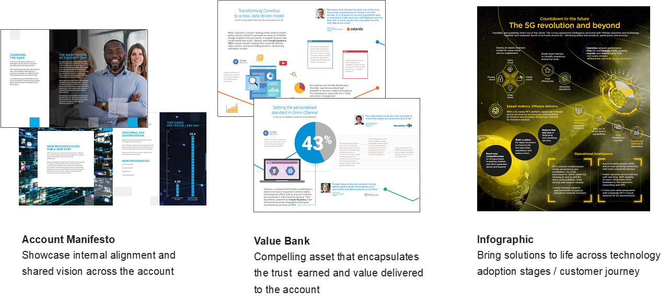
Create customer-centric content
After accounts selected and put in clusters, tailored content is created for use during buying cycle stages.
Notes:
The account manifesto can take several different formats across digital and print. The purpose is to shift perception by showing strategic alignment and shared vision between SAP and the account. This asset also demonstrates deep capabilities and partnership along the ‘tech adoption’ journey.
The value bank is an asset that highlights and underscores the earned trust and reliability of the partnership (to date) – framed in a way that strengthens the argument for expanded partnership and investment. This assets also shows strategic priority alignment and partnership along the journey.
The infographic is a helpful pre-meeting visual aid that makes complex technology adoption feel more accessible, intuitive and logically interconnected. The visuals play a larger role than content – the asset may include use cases (value bank) or more of a vison story (account manifesto)

Slide 19
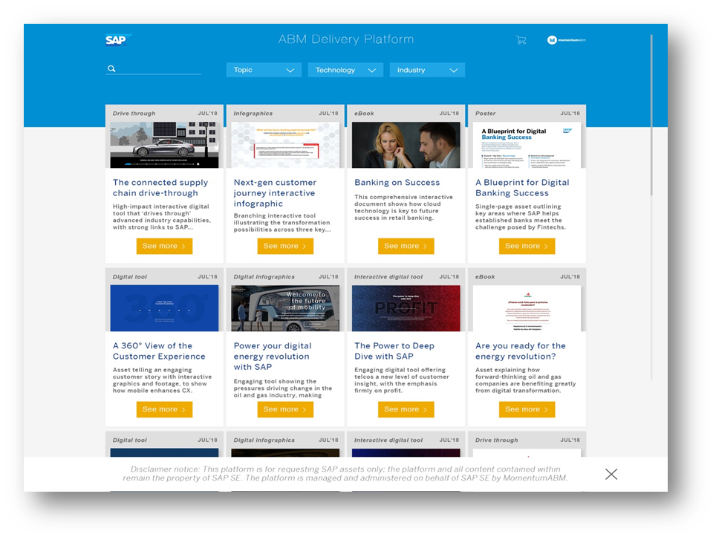
The asset delivery platform
ABM assets are available from the SAP ABM asset delivery platform.
Can be personalised to an account level - or ordered through the platform, choosing whether to make minor or major changes to templates.
http://sapabmassetdelivery.com/
Notes:
Add link

Slide 20
Additional offerings across account tiers
Sales | Digital | Events | Content | SAP ABM Platform
Tier One accounts
Face-to-face meetings Deep Account Planning Executive Sponsor Exec Briefings | 1:1 web personalization PPC, paid social, social selling Intent monitoring | Free SAP Select Pass (5) IDC Engagement Exec Meetings Local roadshows/webinars | Customized executive deck template Customized champion toolkit template Customized dimensional direct mail | Fully customized digital collateral/video (Level 4)
Tier Two accounts
Light Account Planning Customized 1:1 rep e-mail w/ custom topics | Cluster web personalization PPC, social ads, social selling Intent monitoring | Exec Meetings IDC Engagement (select few) Local roadshows/webinars | Semi-customized dimensional direct mail (select few) Other direct Mail & e-mail options (semi-customized) | Personalized digital collateral (Level 2-3)
Tier Three accounts
 | PPC, social ads, social selling Intent monitoring | Local roadshows/webinars | Lightly customized e-mail marketing by topic (Ex. Migration, Innovation) | Generic digital collateral w/ customer URL (Level 1)

Slide 21
Working together

Slide 22

Measuring progress over time
Early Success
  Account Insights
  New Contacts
  Successful Planning
  Sales Utilization
  Account/Contact Activity
Initial Outcomes
  New Pipeline
  Existing Opportunity Progress or acceleration
  Relationship Development
Long Term Value
Revenue Growth and Retention
Increased Loyalty and Advocacy
Improved time to cross-sell revenue

Slide 23
Roles and responsibilities: The gives and gets
What sales gives:
Account knowledge and revenue plans
Meetings, RFP, and event milestones
Feedback from target accounts
Execute on some ABM tactics
What sales gets:
Insights into the account’s business drivers
A set of new contacts to engage with
A marketing strategy that aligns with account goals
Personalized messaging and assets relevant to the account
What regional MDR gives:
Add targeted ABM persona contacts in SFDC
Update RSE new contacts added to leverage ABM assets
Attach contacts to SFDC campaigns for tracking
Execute on some ABM tactics
What regional marketing gets:
Guidance on key contacts to target
Tighter interlock & engagement with sales
Focus on which marketing campaigns to follow-up on
Higher propensity to hit monthly/quarterly goals
Instigate new conversations and challenge perceptions
What regional marketing gives:
Local results and value capture
Feedback, including anecdotal successes
Content requests

Slide 24
Framework and Key Milestones
Preparation | Prioritization | Planning | Execution | Measurement
Selling the idea & building alignment | Top Account selection | Arranging for execution | Reviewing operation progress | Sharing success & discussing next steps
Education Scoping Resources Strategy | Assessment Opportunity Analysis Scoring Selection | Goals Support options Tactic selection Plan delivery | Pilot Full rollout Participation Optimization | Audiences Metric selection Delivery Maturity Audit Benchmarking
January | February | March | April | May
Sales Leader Meetings EMEA & APAC
TAP Playbook, Measurement framework development
List finalization
Ignite Launch to Marketing
Partnered w/ Momentum ABM Agency
Cluster selections & Plans
Field Planning
Program execution
In market execution
SAPPHIRE
EMEA Fusion
Ongoing measurement

Slide 25
From vision to reality
“To create an insight driven and scalable sales and account-based marketing approach that delivers bottom line impact across all regions.”
Notes:
The key is insight-driven impact and scale where all regions can participate regardless of “team” resources – all regions will have access to the same tools and processes.

Slide 26
Your Global Targeted Audience Marketing Team
Denise Kamstra
Alicia Burroughs
Pernilla Putnik
Sarah Chan
Quincy Smith
Stephanie Kolp
Dawn Mathern
Senior Director, Global Targeted Audience Marketing
TAP & GCO Programs Lead Senior Manager
GCO AE Engagement Senior Manager
Program Content Marketing Director
SAP Marketing Senior Manager
Account Based Marketing Senior Manager
Project Manager (external)

Slide 27
Thank you.
Contact information:
  Denise Kamstra
  Senior Director, Global Targeted Audience Marketing
  denise.Kamstra@sap.com

